Slide 1
Introduction to Statistics
Lesson 5.3

Slide 2
Class Objectives
By the end of today’s lesson, you will be able to:
Calculate summary statistics, such as mean, median, mode, variance, and standard deviation, by using Python.
Plot, characterize, and quantify a normally distributed dataset by using Python.
Qualitatively and quantitatively identify potential outliers in a dataset.
Differentiate between a sample and a population in regard to a dataset.
Define and quantify correlation between two factors.
Calculate and plot a linear regression in Python.

Slide 3
Summary Statistics in Python

Slide 4
What is a measure of central tendency?

Slide 5
Measure of Central Tendency = Center of a Dataset
The three most common measures are mean, median, and mode.
Mean
Median
Mode
Mean is the sum of all values divided by the number of elements in a dataset.
Median is the middle value in a sorted dataset.
Mode is the most frequently occuring value(s) in a dataset.

Slide 6
Measures of Central Tendency in Python
Two packages to remember when calculating statistics: NumPy and SciPy.
Mean
Median
Mode
Mean is calculated using NumPy.
Median is calculated using NumPy.
Mode is calculated using SciPy.

Slide 7
When new data comes along, you must plot it!

Slide 8
Why Plot Data?
01
To determine if the data is normally distributed.
02
To determine if the data is multimodal.
03
To characterize clusters in the dataset.

Slide 9
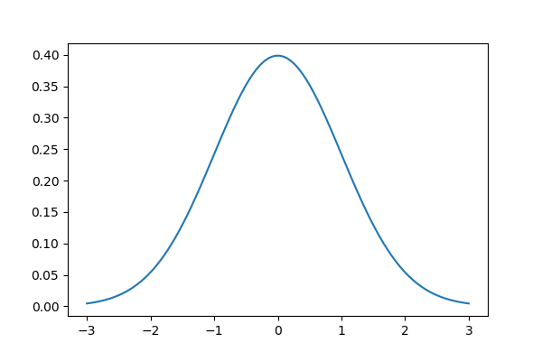
What Is Normally Distributed Data?
01
02
03
The distribution of data follows a bell-curve shape.
We can quantitatively test if a dataset is normal using SciPy.
Some statistical tests assume normally distributed data.
stats.normaltest()

Slide 10
What are variance and
standard deviation?

Slide 11
Variance and Standard Deviation
Variance and standard deviation describe variability of data.
Variance is the measurement of how far each value is from the mean of the dataset.
Standard deviation is the square root of variance.
In Python, both variance and standard deviation are calculated by using the NumPy module.

Slide 13
Quantiles and Outliers in Python

Slide 14
What are quantiles, quartiles, and outliers?

Slide 15
Quantiles, Quartiles, and Outliers
Quantiles, quartiles, and outliers describe a dataset.
Quantiles
Quartiles
Quartiles
Quantiles divide data into well-defined regions based on a sorted dataset.
Quartiles are a specific type of quantile where a sorted dataset is split into four equal parts.
Outliers are extreme values in a dataset that can skew calculations and results.
Q1 | 25% of the data
Q2 | 50% of the data
Q3 | 75% of the data

Slide 16
How to Identify Potential Outliers: Qualitatively
Use box-and-whisker plots to visually identify potential outlier data points.
# Create box plot
plt.boxplot(arr, showmeans=True
plt.grid()
plt.show()
25
20
15
10
5
Upper whisker
Upper quartile
Median
Outlier
Lower quartile
Mean
Lower whisker
1

Slide 17
How to Identify Potential Outliers: Quantitatively
Determine the outlier boundaries in a dataset by using the 1.5 ⨉ IQR rule.
The IQR is the range between
the first and the third quartile.
Anything less than, or below, Quartile 1 — (1.5 ⨉ IQR)
might be an outlier.
Anything greater than, or above, Quartile 3 + (1.5 ⨉ IQR)
might be an outlier.
25
20
15
10
5
1

Slide 18
How to Identify Potential Outliers in Python: Qualitatively
Use Matplotlib’s pyplot.boxplot function to plot the box and whisker.
# Create box plot
plt.boxplot(arr, showmeans=True
plt.grid()
plt.show()
25
20
15
10
5
Upper whisker
Upper quartile
Median
Outlier
Lower quartile
Mean
Lower whisker
1

Slide 19
How to Identify Potential Outliers in Python: Quantitatively
Use Pandas’ series.quantile function to calculate the quantile.
Calculate the outlier boundaries.
25
20
15
10
5
1

Slide 20
Activity: Summary Statistics in Python
In this activity, you will be tasked with calculating a number of summary statistics by using California housing data.
20 minutes

Slide 21
Activity: Summary Statistics in Python
Instructions | Using Pandas, import the California housing dataset from the Resources folder. File: Resources/California_Housing.csv
 | Determine the most appropriate measure of central tendency to describe the population, and then calculate this value.
 | Is the age of houses in California normally distributed? Use both data visualization and quantitative measurement to find out.
 | Examine the average occupancy of housing in California, and determine if there are potential outliers in the dataset. Hint: This dataset is very large.
 | If there are potential outliers in the average occupancy, what are the minimum and maximum median housing prices across the outliers?
Bonus | Plot the latitude and longitude of the California housing data using Matplotlib. Color the data points using the median income of the block. Does any location seem to be an outlier?

Slide 23
Sample, Population, and SEM

Slide 24
Let’s think about
the following scenario...

Slide 25

Predicting the City Election
Weeks before Election Day, a local newspaper wants to predict the winner of the mayoral election. The newspaper will poll voters for their intended candidate. Consider the following:
It would be prohibitively expensive to poll all voters.
It is logistically impossible to know who will actually go out to vote on Election Day.
Therefore, the newspaper must predict the outcome of the election using data from a subset of the population.
This calls for the use of a sample dataset in place of a population dataset.

Slide 26

Population Dataset vs. Sample Dataset
Population Dataset
Sample Dataset
Dataset containing all possible elements of an experiment or study.
In statistics, “population” does not mean “people.”
Any complete set of data is a population dataset.
A subset of population data.
A sample dataset can be selected randomly from the population or selected with bias.

Slide 28
Partner Activity: SEM and Error Bars
In this activity, you will work with a partner to characterize sample data from a California housing dataset. Make sure to compare your calculated values as you progress through the activity.
Take your time—this is an important statistical concept.
(Instructions sent via Slack.)
25 minutes

Slide 29
Partner Activity: SEM and Error Bars
Instructions:
Open samples.ipynb in the activity folder.
Execute the starter code to import the California housing dataset from Scikit-learn.
Using Pandas, create a sample set of median housing prices. Be sure to create samples with at least 20 prices.
Calculate the means and standard error for each sample.
Create a plot displaying the means for each sample, with the standard error as error bars.
Calculate the range of SEM values across the sample set.
Determine which sample has the lowest standard error value.
Compare this sample’s mean to the population’s mean.
Rerun your sampling code a few times to generate new sample sets. Try changing the sample size and then re-run the sampling code.
Discuss with your partner what changes you observe when sample size changes.

Slide 30

Notes:
Image source: AdobeStock_56885471

Slide 32
Correlation Conundrum

Slide 33
Correlation describes the question, “Is there a relationship between A and B?”

Slide 34
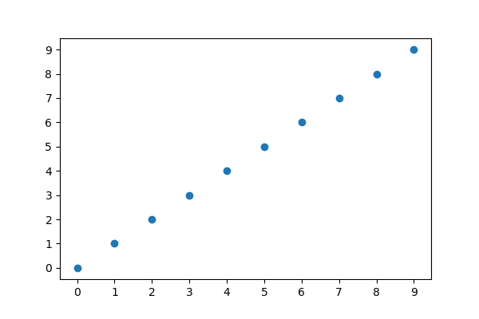
Positive Correlation

Slide 35
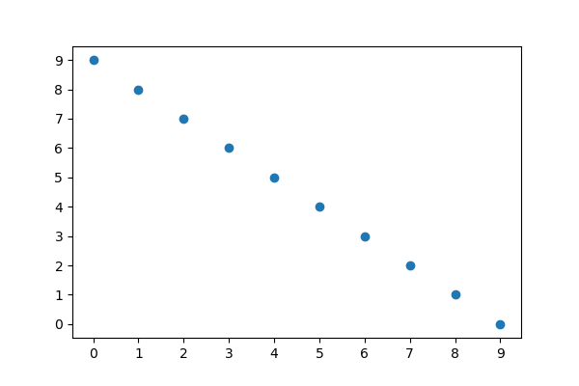
Negative Correlation

Slide 36
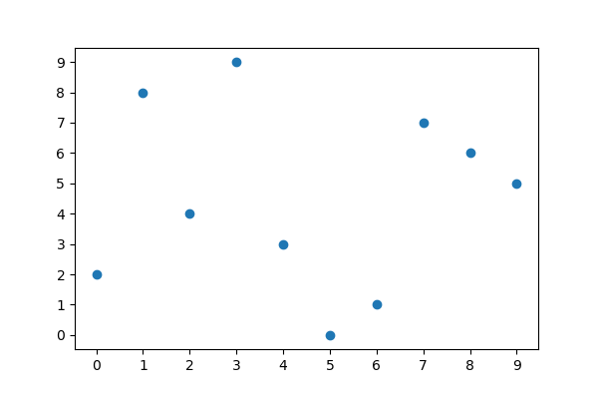
No Correlation

Slide 37
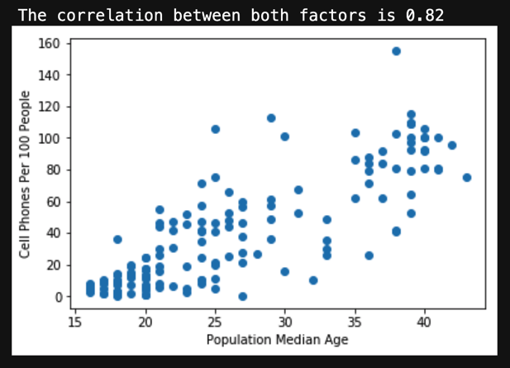
Pearson Correlation Coefficient
In statistics, we quantify correlation using Pearson’s r.
The Pearson correlation coefficient describes the variability between two factors, denoted by the variable r.
Pearson’s r is –1 ≤ r ≤ 1
–1 | Indicates perfect negative correlation.
1 | Indicates perfect positive correlation.
0 | Indicates no correlation.
Real-world data is never perfect.

Slide 38
Activity: Correlation Conquerors
In this activity, you will examine different properties of wine to determine if wine characteristics are correlated.
10 minutes

Slide 39
Activity: Correlation Conquerors
Instructions | Open correlations.ipynb in the activity folder and execute the starter code.
 | Using the dataset, plot the factors flavonoids and malic acid against each other on a scatter plot. Is this relationship positively correlated, negatively correlated, or not correlated? How strong is the correlation?
 | Calculate the Pearson correlation coefficient for malic acid versus flavonoids. Compare the correlation coefficient to the strength of correlation table. Was your prediction correct?
Pearson’s Correlation
Absolute Value of r | Strength of Correlation
r < 0.3 | None or very weak
0.3 ≤ r < 0.5 | Weak
0.5 ≤ r < 0.7 | Moderate
r ≥ 0.7 | Strong

Slide 41
Fits and Regression

Slide 42
What is the equation of a line?

Slide 43
The equation of a line is:
y = mx + b
Dependent variable
Slope
Independent variable
y-intercept

Slide 44
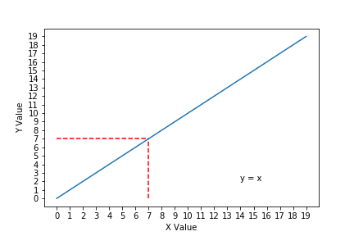
The Equation of a Line Determines y Values Given x
In this example:
Slope = 1
y intercept = 0
Whatever x is, the value of y is the same.

Slide 45
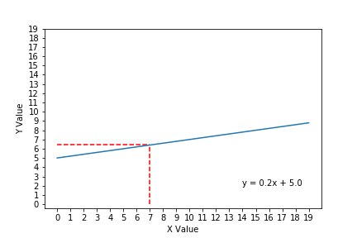
The Equation of a Line Determines y Values Given x
In this example:
Slope = 0.2
y intercept = +5
If x = 7, then y = 6.4

Slide 46
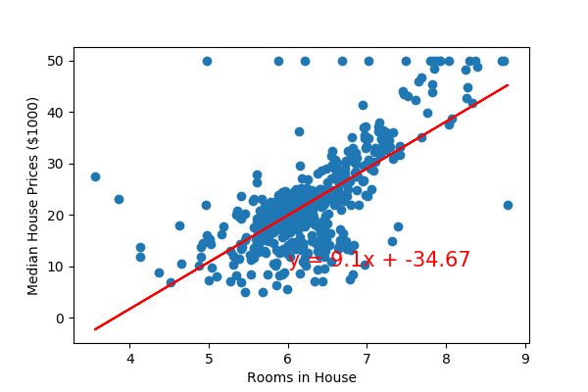
Linear Regression Fits the Equation of a Line to Real-World Data
Linear regression:
Predicts the values of factor B given values of factor A.
Estimates where unmeasured data points might end up if more data was collected.
Is used to predict housing prices, stock market, weather, etc.

Slide 47
Activity: Fits and Regression
In this activity, you will predict the crime rates in 2019 by using linear regression models.
15 minutes

Slide 48
Activity: Fits and Regression
Instructions | Open crime.ipynb, and execute the starter code.
 | Generate a scatter plot with Matplotlib using the year as the independent (x) variable and violent crime rate as the dependent (y) variable.
 | Use stats.linregress to perform a linear regression with the year as the independent variable (x) and violent crime rate as the dependent variable (y).
 | Use the information returned by stats.linregress to create the equation of a line from the model.
 | Calculate the predicted violent crime rate of the linear model using the year as the x-value.
 | Plot the linear model of year versus violent crime rate on top of your scatter plot. Your scatter plot and line plot share the same axis. To overlay plots in a notebook, the plots must be in the same code block.
 | Repeat the process of generating a scatter plot, calculating the linear regression model and plotting the regression line over the scatter plot for year versus murder rate and year versus aggravated assaults.
Bonus | Use pyplot.subplots from Matplotlib to create a new figure that displays all three pairs of variables on the same plot.

